Slide 1
Attribution…. Self Plagiarism – what to do for the thesis writing
Garry T Allison

Slide 2
Outline
Authorship
It is a commodity it has a value.
Authorship is earned.
Examiners
What should the student tell the examiners?
Attribution
Papers published
Papers in preparation
Plagiarism
Stealing something and then saying where you stole it from does not mean you did not steal it. - You have to tell the ‘examiner’ who owns it.

Slide 3
Authorship
If an academic fulfils the role of an advisor and collaborator in the development and guidance of the research paper then it would seem obvious that they should be/ would be an author.
Authorship on great papers is the equivalent to gold.
Authorship is a commodity and has value.
There are standard systems to award authorship.
automatically give Authorship to the person who owns the instrument or is Head of Department?
automatically give Authorship to the supervisor?
Is that OK?
The world has changed ….it is NOT appropriate to do this.

Slide 4
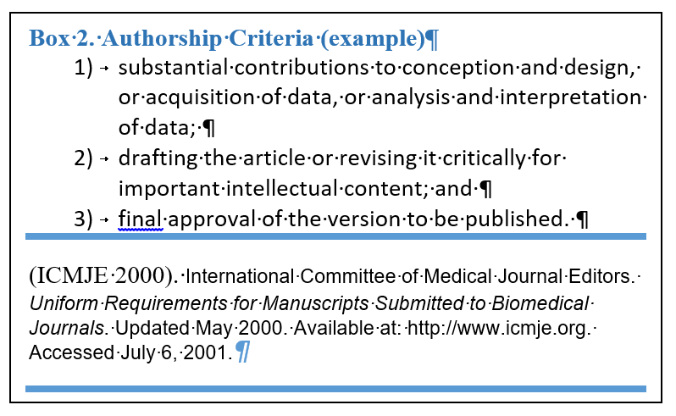

Slide 5
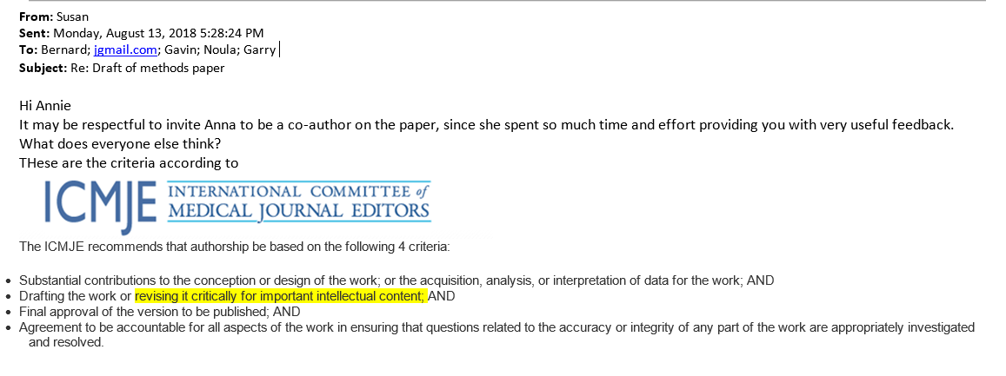
It happens – a conversation that is normal

Slide 6
What can I put into my thesis ?
You CAN put in anything into the thesis
……… so long as you attribute it (correctly)!
OK –.. If you have IP restrictions etc. there are some limitations but this is the difference between the thesis for examination to get the award vs. the “Thesis” or “final Thesis” that is in the public domain (eSpace / Library).

Slide 7
Thesis attribution of papers published or being submitted
Box 4. “But it is MY paper and my work….”
When a HDR candidate co-authors a 1st author paper. They have a personal connection to the work. It is placed in the public record as an independent research output. In many cases the ‘ownership’ transfers to the publisher through a copyright agreement. Even if the publishers allows the authors freedom to maintain copyright –all the authors share the copyright. The HDR candidate cannot replicate the work in the publication without reference or attribution… even if they think it is “their paper”. This perception is often related to inappropriate (i.e. Honorary) authorship.

Slide 8
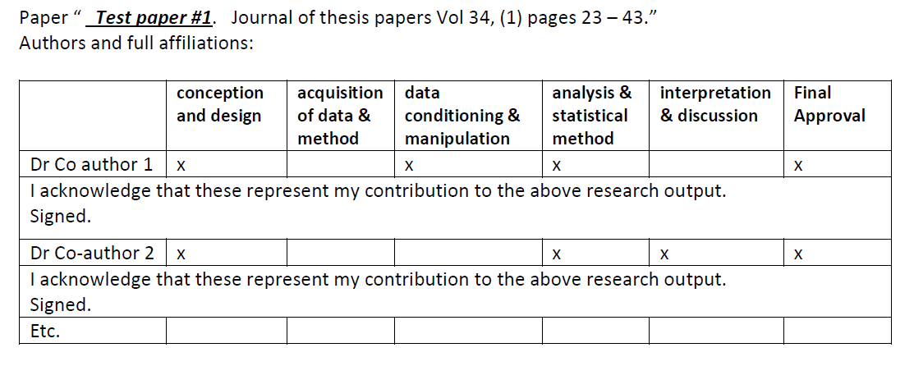
Authorship – Roles vs % allocation
Examples. ….

Slide 9
Go to the web site and find the attribution statement

Slide 10
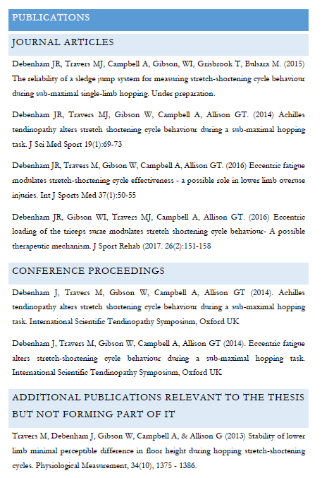
Acknowledgement
In front of the thesis – acknowledgements & Outputs.
In front of the thesis chapters.
Co-authorship.
Papers published.
In-press and even in preparation

Slide 11
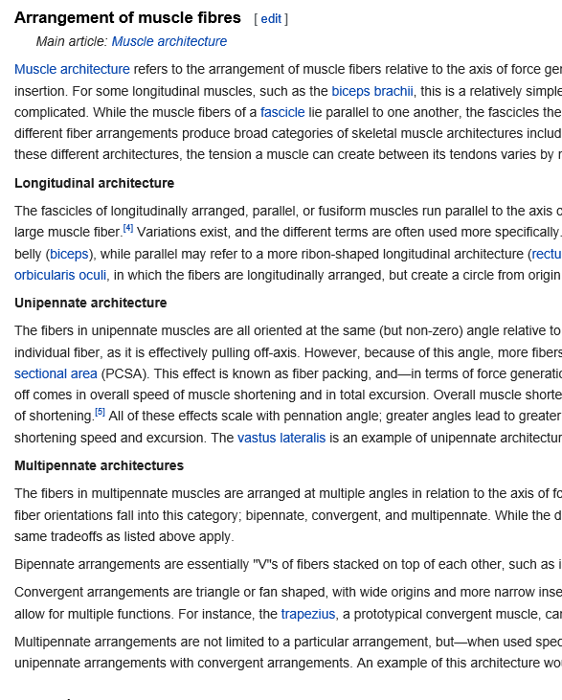
Are parts of the thesis more important than others?
“ the literature review is not that important”… “ the value of my original research is the study and the original results… “
Literature review
Muscle fibre architecture [wiki ref]
insert text….

Slide 12
Criteria to Examine a Doctoral Thesis
“In particular, the thesis should demonstrate that the candidate has:
a) adequately surveyed literature relevant to the thesis;
b) adequate skills in the gathering and critical analysis of information and report presentation;
c) demonstrated the capacity to conceive, design and carry to completion independent research; and
d) made a substantial, original and significant contribution to the knowledge or understanding in the field of study.
In assessing the thesis, the examiners should prepare a report on the prescribed form, indicating whether the criteria in (a) - (d) have been satisfied and, if not, what modifications are necessary to reach this standard."
(See http://research.curtin.edu.au/postgraduate/research-staff/ - Thesis Examination - Advice for Examiners)

Slide 13
Criteria to Examine a Master’s Thesis
“In particular, the thesis should demonstrate that the candidate has:
a) adequately surveyed literature relevant to the thesis;
b) adequate skills in the gathering and analysis of information and report presentation;
c) demonstrated the capacity to conceive, design and carry to completion independent research; and
d) made a substantial contribution to the knowledge or understanding in the field of study.
In assessing the thesis, the examiners should prepare a report on the prescribed form, indicating whether the criteria in (a) - (d) have been satisfied and, if not, what modifications are necessary to reach this standard."
(See http://research.curtin.edu.au/postgraduate-research/hdr-staff/hdr-staff-forms/ Advice for Examiners)

Slide 14
The thesis literature review….
This is a summary of the thematic elements in the literature …
NOT
A summary of papers in the literature.
“Sorry, I forgot to paraphrase very well”
Copying text and changing the words rarely reflects the THEMATIC analysis.

Slide 15
Research Integrity Training & Turnitin
Research Integrity training - Developed by Epigeum in collaboration with Australian Universities
Compulsory for all researchers - HDR students and staff
HDR students complete BEFORE candidacy submitted.
Found on Blackboard, login via Student OASIS (pic next slide)
It contains links for ‘Originality Checking’, i.e., Turnitin – text matching software – to assist students avoid plagiarism
Use the Turnitin links to check candidacy proposal and thesis chapters
See Research Integrity website and What is Turnitin
Turnitin is a text matching software and identifies where common clusters of words match. – So it picks up the copy and paste… and assistance by Dr Google or Prof Wiki…
AND
If individuals try to get around this
You still have much to learn.
Speaking like Yoda is still plagiarism!!!!

Slide 16
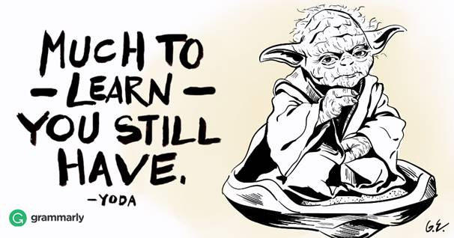

Slide 17
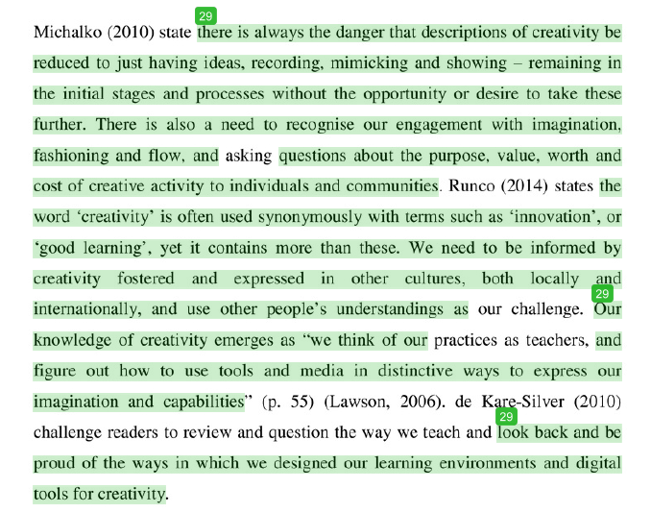
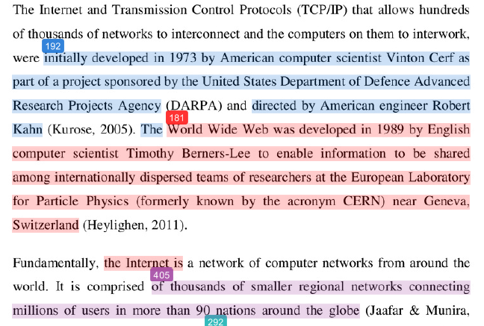
Turnitin – there is no % threshold.

Slide 18
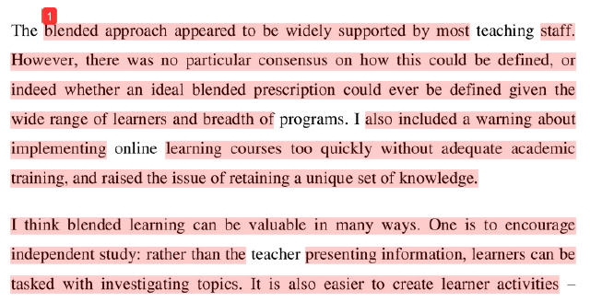
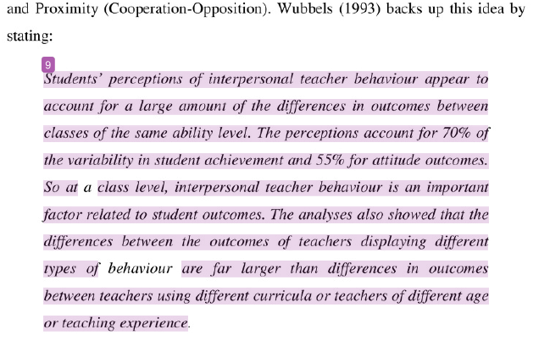
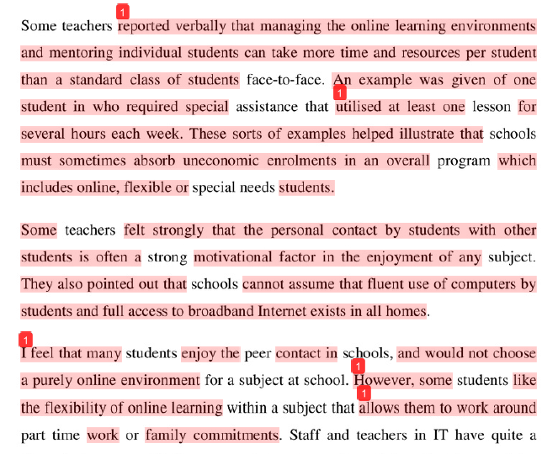
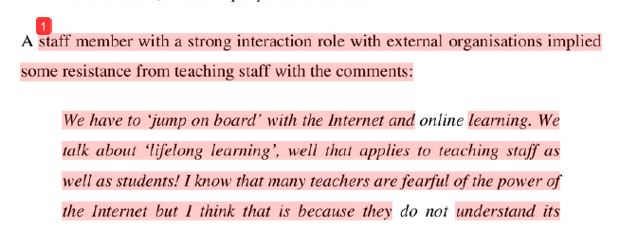

Slide 19
Conundrum….. Discussion..
The final thesis needs to be run through Turnitin.
The supervisor signs off on the report….
If the thesis is found to have plagiarism – who do I talk to?

Slide 20
Thesis attribution
1. Acknowledgements
2. From this thesis the following research outputs have been developed.
References – Papers, Conferences, Awards.
Include all authors.
If it is a full paper then the attribution is at the chapter level.
3. Paper contributions
Examples
4. Papers under development (submitted).
Give title and authors not journal.

Slide 21
Questions and examples
1. Should the student be 1st Author?
2. What happens if a paper is written by two students can they use the same paper?
3. Can I use a paper that has been published and the copyright has been transferred?

Slide 22
Examined Thesis vs. Public Thesis
You can put anything into the thesis
The publicly available Thesis (eSpace) can be different to the Examined Thesis.
If the paper is published (and copyright has been transferred) then the paper will be redacted from the eSpace version. But it can still be in the thesis for examination.

Slide 23
Questions?

