Slide 1
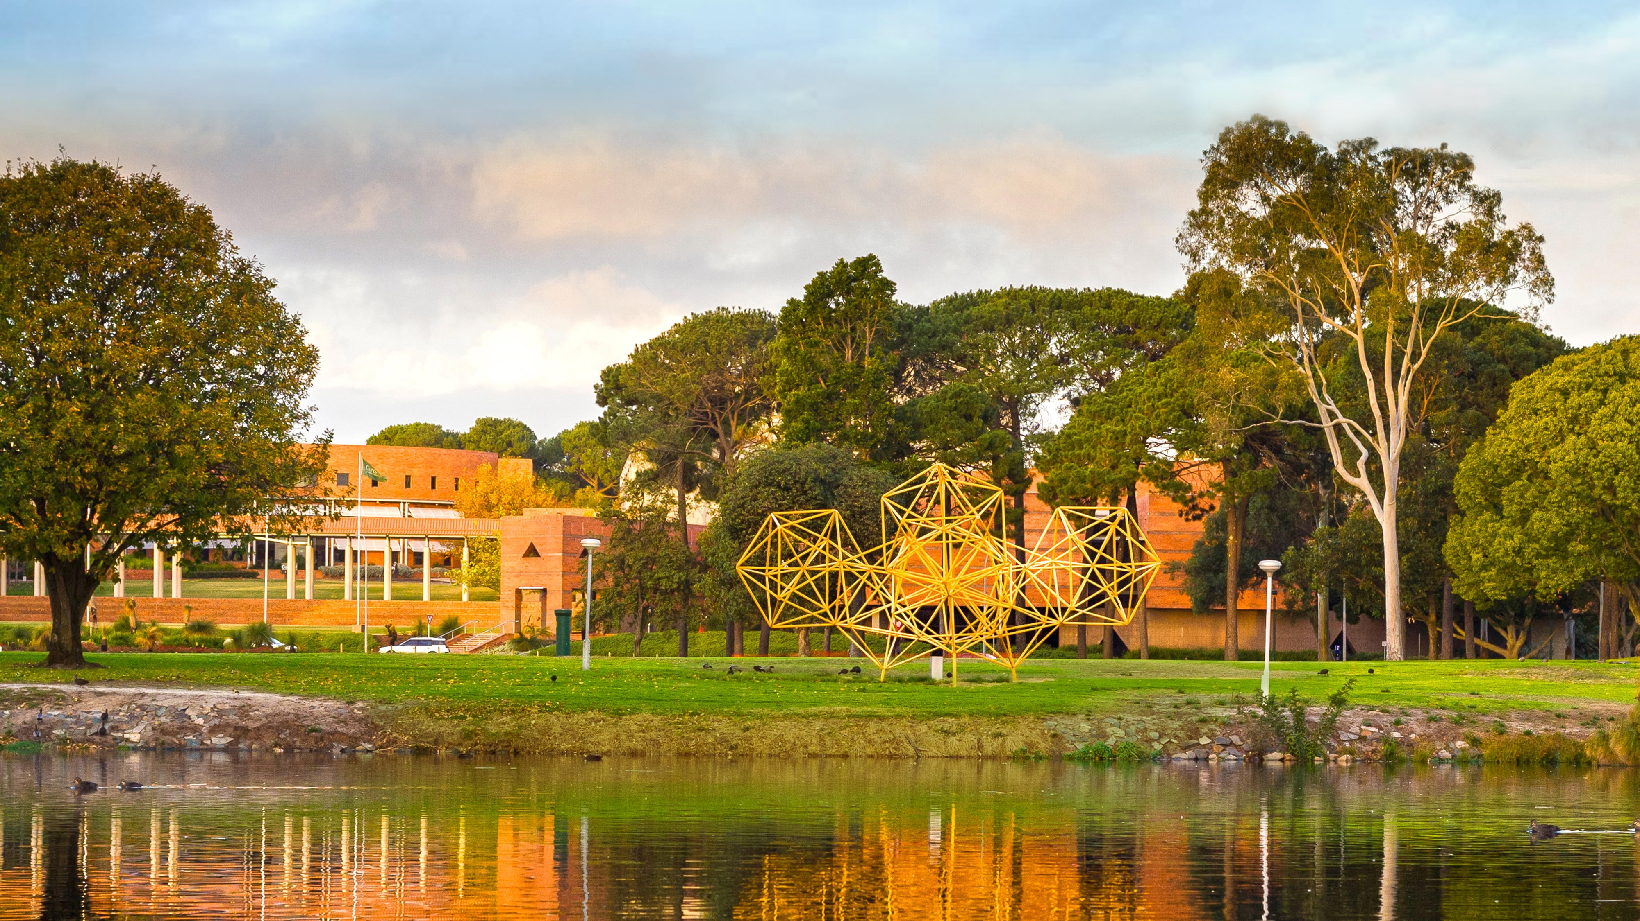
HDR Thesis Examination Process
Christopher Reid
John Curtin Distinguished Professor
Dean Graduate Studies, Curtin University
Graduate Research School September, 2021
Notes:
Thanks very much and I am pleased to have the opportunity to discuss with you what I see as one of the most exciting developments in clinical and medical research in this country coming at a time when Curtin University has
A very strong allied health training reputation in most of the key disciplines
The newest medical school in the country and
is becoming a major force in health research not only in he State but also Nationally.

Slide 2


Acknowledgement of Country

Slide 3
In this seminar
Who does what?
The Rules and criteria
The examiner

Slide 4

Milestone Model for Progression
Milestone 1
Milestone 2
Milestone 3
Enrolment
Examination

Slide 5
Milestone 3
The pre-submission oral presentation of the thesis work
A pre-submission approval / acknowledgement
(not an oral defence/ examination of the thesis like most other Institutions)
Completed around 3 months prior to submission.
Supervisor will nominate examiners at this time

Slide 6
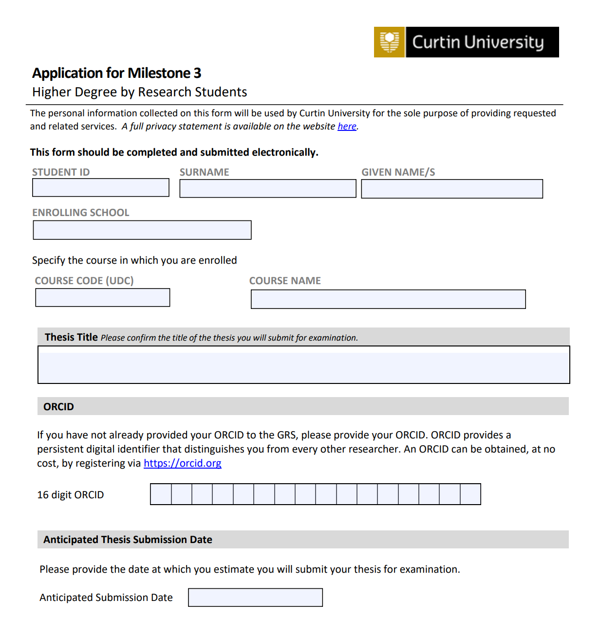
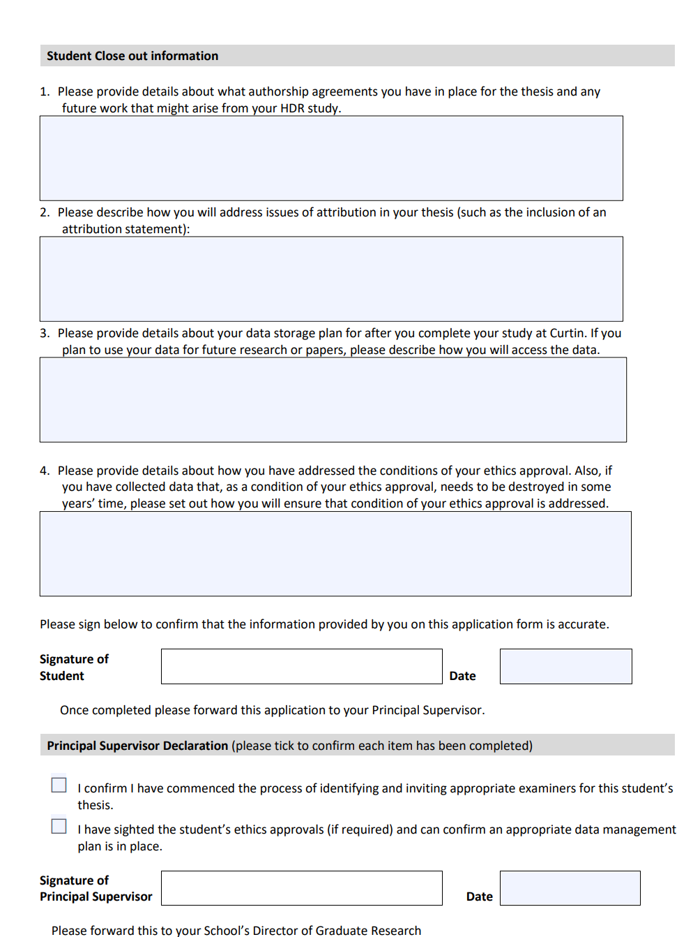
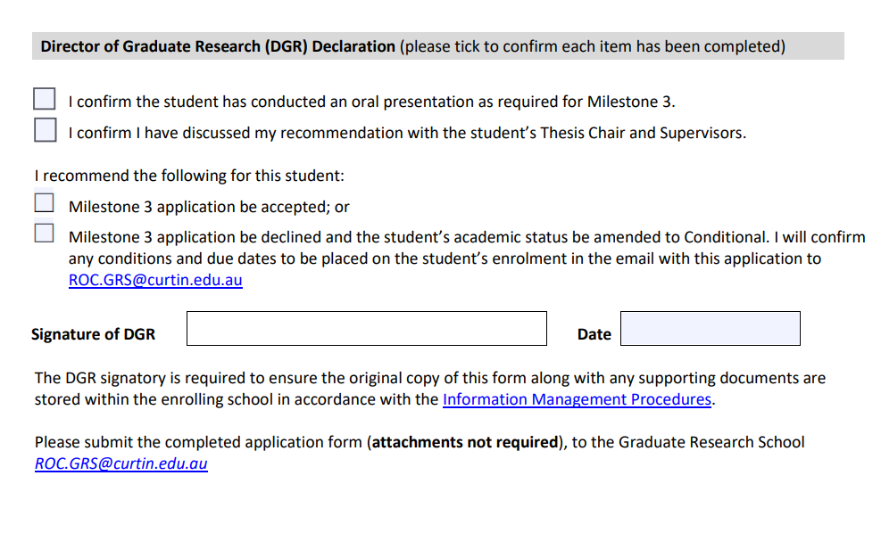
Milestone 3 Application Form

Slide 7
Responsibilities for Submission – The Student
prepare (with the help of their supervisor) their thesis as a comprehensive academic/scholarly argument in approved format
appropriately acknowledge IP, copyright, ethics approvals etc attribute authorship
submit electronically (hard copy only if examiner specifically requests it)

Slide 8
Responsibilities – The Supervisor
supervise the research contents and writing of the research thesis to a high academic standard
read the thesis as it evolves and provide timely feedback
nominate examiners in a timely fashion so as not to delay the student’s submission.

Slide 9
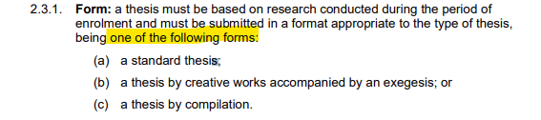
Preparing the Thesis - Requirements
  Follow requirements of the (HDR) Thesis Examination Procedures and Guidelines

Slide 10
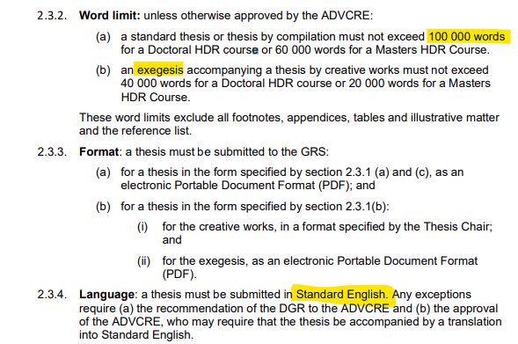
Preparing the Thesis - Word limit, format, language

Slide 11
Thesis Submission and Examination
2 External expert Examiner (for Mphil, 1 internal examiner from a different enrolling school is allowed
Written review and opportunity to respond if require
Pass with minor or major amendments, Re-examine or
Fail
Examiners –review takes 1-2 months
Student amendments (up to 6 months*)

Slide 12
Choosing Examiners
Panel - Chair of the Thesis Committee, plus TWO Examiners
  Masters: At least one examiner must be external to Curtin
  Doctoral: Both must be external to Curtin
Examiners should possess an equal or greater qualification to that being sought – or of equivalent status with recognised standing in the field
There should be a judgment of risk for a perceived conflict of interest between the examiner and candidate/ supervisors/ university

Slide 13
Choosing the Examiner - Best Practice: Avoid Major Conflicts
Relationships
Student and Examiner:
  Personal (relative, previous relationship, mentor)
  Working (co-authorship, supervisory, employment)
  Business/professional (business partner, trustees)
Supervisor and Examiner
  Personal (relative, previous relationship, mentor)
  Working (co-authorship, supervisory, employment, grant, patent)
  Business/professional (business partner, trustees)
In the past 5 years

Slide 14
Choosing the Examiner - Best Practice: Avoid Major Conflicts
Relationships :
University and Examiner:
  Working (external reviewer, employment, previous examination in last year)
  Other (Former grievance, graduate, Honorary Doctorate)
  Business/professional (current staff or former within 5 years)
Other:
  Commercial interest in outcome
  Two examiners in same school/department
  Two examiners in close personal relationship
  Your mum…. ☺
It is best to tick
Minor Conflict of Interest
and then explain…
Rather than…
NO Conflict of Interest
and try to defend it ..
Because it is about the risk of PERCEIVED conflict of Interest …
and the judgement is someone's else’s perception…. Not yours.

Slide 15
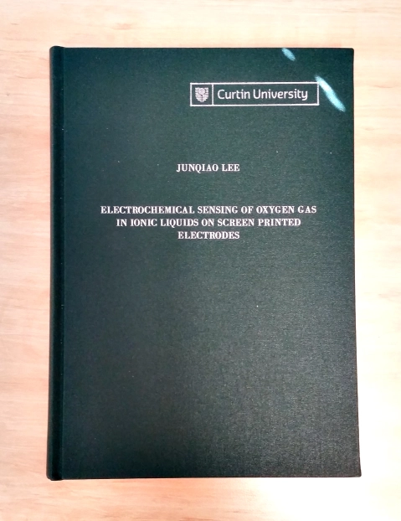
Thesis examination
We send to examiners:
  Thesis as pdf (hard copy if requested, or for creative
  works)
  Criteria on which thesis is to be judged
  Report form
  Honorarium payment form
They send us:
The examination report (provides an overall assessment detailing the strengths and weaknesses of the thesis)
(See https://staffportal.curtin.edu.au/research/hdr-supervision/candidacy/ Thesis Examination - Examination Report Example)

Slide 16
Responsibilities – The Examiner
Examiners are nominated as experts in the area with a National or International reputation. They have the qualification plus research activity/outputs reflecting their expert status.
Examiners are asked to:
evaluate the thesis against a given set of criteria
make a recommendation as to how the thesis should be classified
write a report providing the grounds for their recommendation
Examiners respond to each of the examination criteria plus the quality of the publications / journals selected (if applicable).

Slide 17
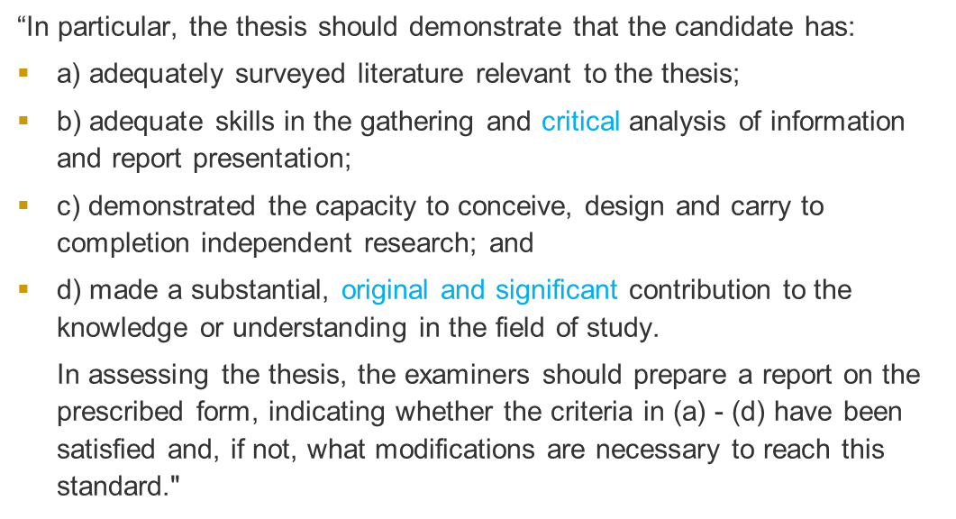
Criteria to Examine a Doctoral thesis

Slide 18
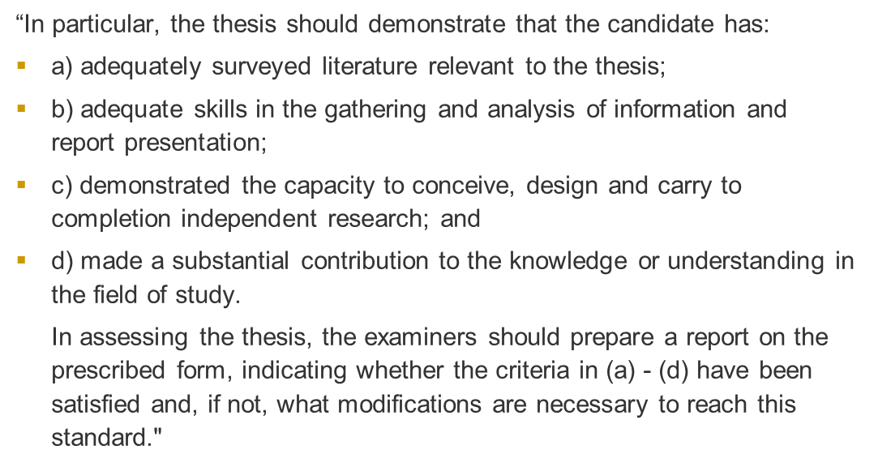
Criteria to Examine a Master’s thesis

Slide 19
How do examiners read a thesis?
Read the abstract, introduction and conclusions to get a sense of the thesis
Look at the scope of the literature review
Read the thesis making detailed notes
Take a final read through with reference to the notes
Write a report

Slide 20
Questions examiners ask themselves…
How would they have tackled the problem set out in the abstract and the title?
What questions would they like answers to?
Do the conclusions follow on from the introduction?
How well does the candidate explain what he/she is doing?
Is the bibliography up-to-date and substantial enough?
Are the results worthwhile?
How much work has actually been done?
What is the intellectual depth and rigour of the thesis?
Is this actually ‘research’ - is there a scholarly argument?

Slide 21
Attribution
 | Paper #1 Systematic review / meta analysis | Paper #2 Reliability and Validity | Paper #3 Clinical Trial - outcomes
conception and design | x | x | x
acquisition of data & method | x
data conditioning & manipulation | x | x | x
analysis & statistical method |  | x
interpretation & discussion |  |  | x
Final approval | x | x | x
Front of the thesis or chapter:
The following research outputs have been generated form the work within this thesis.
 | conception and design | acquisition of data & method | data conditioning & manipulation | analysis & statistical method | interpretation & discussion | Final Approval
Dr Co author 1 | x |  | x | x |  | x
I acknowledge that these represent my contribution to the above research output. Signed.
Prof Co-author 2 | x |  |  | x | x | x
I acknowledge that these represent my contribution to the above research output. Signed.
Etc.

Slide 22
What makes a good thesis? Scholarship!
Originality, coherence, and a sense of student autonomy or independence.
Development of a well-structured argument is highly valued.
Most examiners look for sufficient quantity as well as quality of work.
Reflection: students make a critical assessment of their own work; they recognise and deal with problems.
A level of sophistication in the way students present their argument.
BUT …….. Quantity is not a substitute for quality

Slide 23
What makes a poor thesis? Sloppiness!
adequately surveyed literature relevant to the thesis;
Characteristics of a poor thesis are:
lack of coherence
lack of understanding of the theory
lack of confidence in writing
researching the wrong problem
mixed or confused theoretical and methodological perspectives
work that is not original
not being able to explain at the end of the thesis what had actually been argued in the thesis.
demonstrated the capacity to conceive, design and carry to completion independent research
adequate skills in the gathering and critical analysis of information and report presentation;
An original and significant contribution to the field of research

Slide 24
What do we know about how examiners examine theses?
Considerable Australian research has analysed examiners’ reports and the findings indicate that:
Examiners require all of the normal forms of assistance which should be provided to any reader.
They appreciate work that is logically presented, focused, succinct, summarised and in which signposts are used to help readers to understand the path taken through the work…
If work is poorly presented, examiners tend to lose confidence in the candidate and may think that there are deeper problems, such as superficial conceptualisation and a lack of critical analysis.

Slide 25
What do examiners look for?
Examiners open the thesis with the intent to pass it.
If you can not number pages consistently, spelt commons words correcttedly,… if yous incorrectly label or format FIgureS and taBles, incorrectly say the examiners research used rabbits instead of rats, the examiner will then question your ability to conduct the actual research. …
Try to make the thesis look great….polished scientific… etc
Clearly articulated research question
Sound understanding of methodology
Clearly presented results
Well argued discussion and justified conclusions
AND
Clear use of English
Spelling and grammar
Accurate references

Slide 26

Questions?

Slide 27
Responsibilities post examination – Student & Supervisor
Student
  make amendments, as required by examiners; submit digital thesis to espace (institutional repository) and arrange (optional) permanent binding of the final thesis
Supervisor
  assist the student to make any required amendments to the thesis based on the examiners comments

Slide 28
Examiner Report Form – Recommendation (1)
Examiners select only one of the five recommendations below:
PASS
The thesis be classified as PASSED with no requirement for correction other than minor typographical or editorial matters. The Thesis Chair will require that the candidate correct such errors as pointed out by the Examiner; or
The thesis be classified as PASSED after the candidate has made minor textual and/or structural amendments to the satisfaction of the Thesis Chair as outlined in the Examiner’s Report; or
A
B1

Slide 29
Examiner Report Form – Recommendation (2)
The thesis be classified as PASSED provided the candidate has revised specific sections of the thesis to the satisfaction of the Thesis Chair as outlined in the Examiner’s Report. The Examiner may specify this category for a thesis which requires substantive revisions that will not change the substantive conclusions of the thesis; or
B2
  Pass:
  pass with no requirement for correction or amendments other than minor typographical and editorial matters;
  pass subject to minor content, textual and/or structural amendments being made to the satisfaction of the Thesis Chair; or
  pass subject to major content, textual and/or structural amendments being made to the satisfaction of the Thesis Chair;

Slide 30
Examiner Report Form – Recommendation (3)
The Thesis be SUBMITTED IN A REVISED FORM FOR RE-EXAMINATION by the original Examiner after further research, rewriting, re-organisation, and/or re-conceptualisation. The Examiner may specify this category for a thesis which requires major, substantive amendments. In the report the Examiner shall provide detailed guidance to the candidate to assist revision; or
C

Slide 31
Examiner Report Form – Recommendation (4)
The thesis be classified as FAILED, without right to resubmit the thesis, on the basis that a significant amount of additional research work and/or major substantive revision will not raise the thesis to an acceptable standard.
F

Slide 32
Issues – No clear weight of opinion
Ex. 1. Pass no amendment, Ex. 2. Resubmit
Ex. 1. Fail, Ex. 2. Pass
Where the examiners’ reports do not allow the Thesis Chair to determine an examination result based on a clear weight of opinion, the Thesis Chair, having discussed the reports with the supervisors, may recommend to the ADVCRE (via the DGR):
the appointment of an adjudicator (see section 2.5); or
an oral examination of the student (see section 2.6).
    Where:
the examiners’ reports allow the Thesis Chair to determine an examination result based on a clear weight of opinion;
the Thesis Chair has received an adjudicator’s report; or
the Thesis Chair has received an oral examination panel’s report,
the Thesis Chair, having discussed the reports with the supervisors, is to recommend to the ADVCRE (via the DGR) that the thesis be classified in accordance with the classification set out in section 2.4.4.

Slide 33
Using an adjudicator in the examination process
On the recommendation of the Thesis Chair the ADVCRE may appoint an adjudicator to adjudicate between examiners’ reports.
In consideration of a thesis:
  which has not been submitted for re-examination, the report of the adjudicator must recommend a classification of pass (under section2.4.4(a)), re-examine (under section 2.4.4(b)) or fail (under section 2.4.4(c)); or
  which has been submitted for re-examination the report of the adjudicator must recommend a classification of pass (under section 2.4.4(a)) or fail (under section 2.4.4(c)) and a recommendation of re-examine (under section 2.4.4(b)) cannot not be made.
The report of the adjudicator is to be conveyed by the GRS to the Thesis Chair who is to then make a recommendation under section 2.4.7.

Slide 34
Appeals
Appeal against classification of thesis considered on the basis of
  Bias on the part of an examiner
  Procedural irregularities in the examination
Student must submit appeal documentation within 28 days of receiving fail grade
DVC decides if a prima facie case exists, if yes
Appeals Committee convened

Slide 35
Higher Degree by Research Completions
Result | 2016 | 2017 | 2018 | 2019 | 2020
Pass (A) | 12% | 8% | 14% | 14% | 13%
Pass (B1 & B2) | 82% | 87% | 77% | 80% | 82%
Resubmit C | 6% | 4% | 9% | 6% | 5%
F | 0% | 0.58% | 0.62% | 0.32% | 0%
Totals (n) | 307 | 348 | 311 | 327 | 348
92% 94% 95% 94% 95%
Key to Result Column:
P: Pass, no amendment
A: Pass, having been amended (includes B1 and B2 options)
R: Pass, having been resubmitted
F: Fail
Examiner Recommendations – Percentage (Source: Script Database, Thesis Examinations module, generated 4 Janyary 2021)

Slide 36
Policy & Guidelines
HDR Thesis Examination Policy
HDR Thesis Examination Procedures
Guidelines
  Guidelines for Thesis Preparation and Submission [.docx 60KB]
  Guidelines for Professional Thesis Editing [.pdf 297KB]
  Guidelines for Conflict of Interest for Thesis Examination [.pdf 174KB]
General info on preparing the thesis; submitting; examination

Slide 37
Forms
Forms and Guidelines for Thesis Submission for links to:
  Online Nomination of Examiners (Staff access only)
  Online Thesis Submission for Examination (HDR student access only)
  Request for extension of time to submit/resubmit thesis [.pdf 219KB]
  Thesis Title Page template [.docx 26KB]
  Thesis Declaration [.pdf 70KB]
  Examination Report (example) [.pdf 491KB]
  Submission of Digital Thesis [.pdf 196KB]
  Thesis Permanent Binding [.pdf 317KB]
Graduate Research School for all queries ROC.GRS@curtin.edu.au or phone x2111

Slide 38
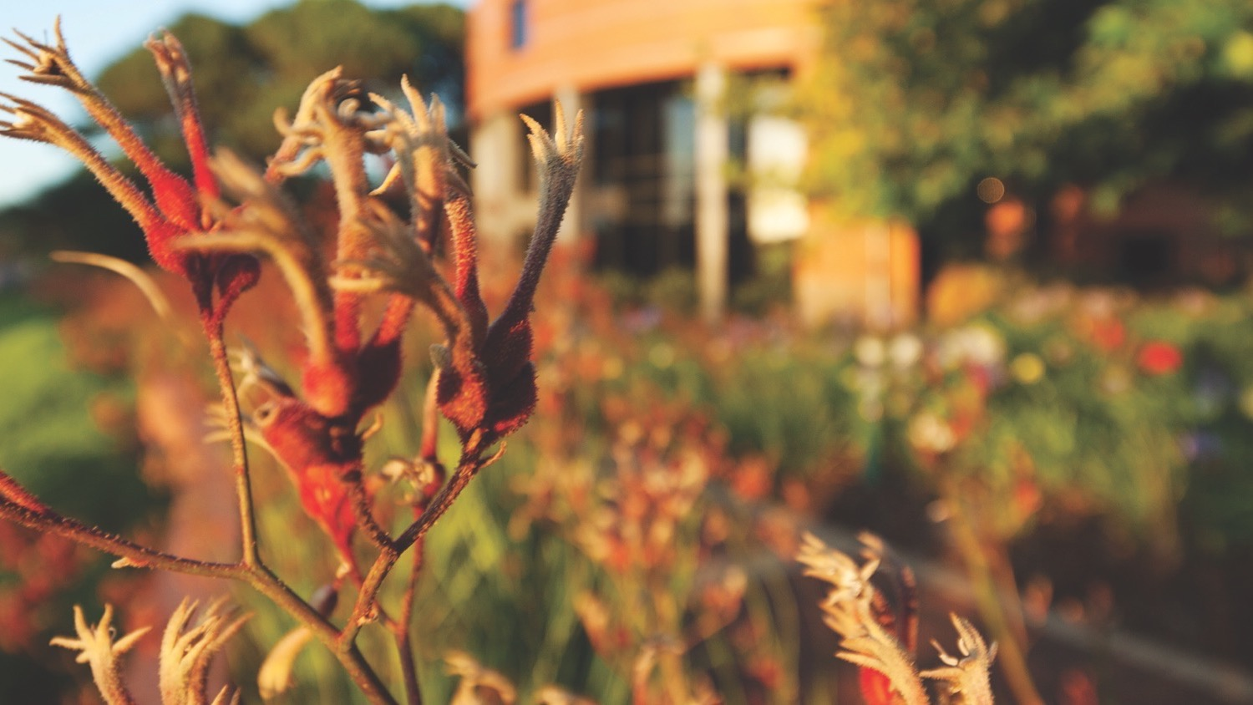
Thank you
Make tomorrow better.

Slide 39
Plagiarism…. Attribution…Acknowledgement
Box1. Examiners need to receive full disclosure of contributions to the thesis.
When an examiner is asked to assess a thesis it is absolutely necessary that the content of the thesis has the appropriate references, as well as attribution of the work by co-authors or work that has been published from the thesis.
Copy and paste 1000 words from Wikipedia could mean you lose your thesis/award.
Even if you “reference” the document.
  2.2.1 Measurement of muscle stiffness [wiki]
Attribution. Examiners need to be fully informed of the attributed works in the thesis
Box 2. Authorship Criteria (example)
substantial contributions to conception and design, or acquisition of data, or analysis and interpretation of data;
drafting the article or revising it critically for important intellectual content; and
final approval of the version to be published.
(ICMJE 2000). International Committee of Medical Journal Editors. Uniform Requirements for Manuscripts Submitted to Biomedical Journals. Updated May 2000. Available at: http://www.icmje.org. Accessed July 6, 2001.

Slide 40
Finally…. Thesis by compilation
This is a growing trend but be careful to ensure papers are NOT just ‘ordinary’ or low quality or are part of a ‘salami- sausage’ (*) approach.
(*) [ One research project cut up into a large number of very thin sliced “papers” ].
Not 1st Author…. Makes difficult attribution or originality.

Slide 41
PhD/MPhil degrees in Australia given solely on the evaluation of the thesis (except for creative work/exegesis)
Important that the student realises this
Important that the thesis is written such that it accurately reflects the student’s research achievements
Important that the student is fully transparent in their attribution of work, particularly for published outputs with co-authors

