Slide 1
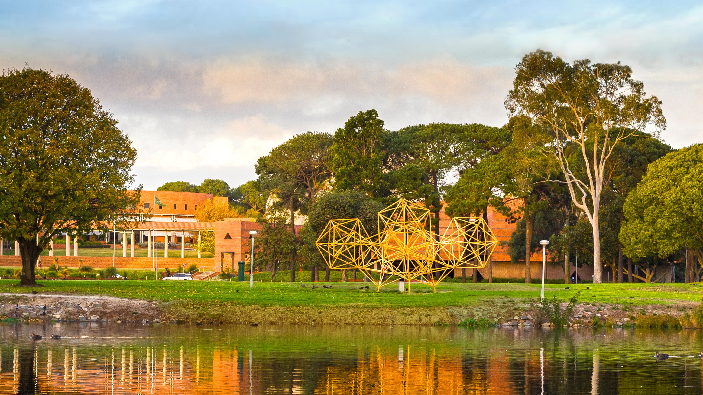
Thesis by Compilation
Christopher Reid
John Curtin Distinguished Professor
Dean Graduate Studies, Curtin University
Graduate Research School August 2021
Notes:
Thanks very much and I am pleased to have the opportunity to discuss with you what I see as one of the most exciting developments in clinical and medical research in this country coming at a time when Curtin University has
A very strong allied health training reputation in most of the key disciplines
The newest medical school in the country and
is becoming a major force in health research not only in he State but also Nationally.

Slide 2


Acknowledgement of Country

Slide 3

Housekeeping
We have many attendees today!
Please keep microphones muted and do not display your video unless speaking to ask a question when invited to do so. This will conserve bandwidth.
The event will be recorded and made available soon after.
Make comments or pose questions by typing them into our Slido Q&A tab embedded in WebEx.
Attendees can up-vote questions which they want prioritised.
can also use https://bit.ly/2UScRuK

Slide 4
Links to Policy…Procedures…Guidelines
Guidelines for Thesis Preparation and Submission
  Section 3 “Additional requirements for the preparation of a thesis by compilation”
  Section 4 ‘Attribution of research outputs in the HDR thesis”
Australian Code for the Responsible Conduct of Research 2018 – Authorship
Authorship, Peer Review and Publication of Research Outputs Policy
Authorship, Peer Review and Publication of Research Outputs Procedures

Slide 5
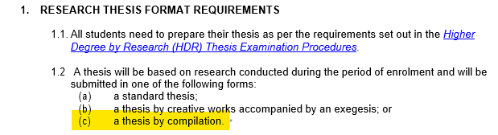
Guidelines for Thesis by Compilation

Slide 6
What is a standard thesis?
  At beginning: Table of contents, lists of tables and figures, declarations, dedications, attributions and abstract
  Set series of chapters: Introduction and literature review, Methods chapter, Results chapter, Discussion and Conclusions chapter(s).
  At end: References and then a series of appendices.
  See examples in the Library’s espace.
  The research area may have a standard practice (consider expectations of examiners)
  Thesis must as a whole form a coherent narrative, structure may vary by the nature of the research process unique to that thesis.

Slide 7
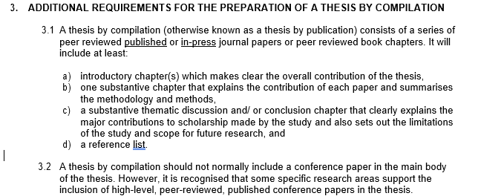
Thesis by compilation (publications)

Slide 8
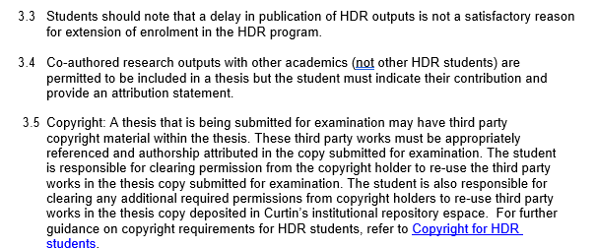
Thesis by compilation (publications)

Slide 9
Hybrid model
  Currently, most research theses are a mix of the standard (chapters) and the compilation models.
  These are varied and are a ‘hybrid’ thesis.
  Curtin does not define the hybrid thesis as it is becoming the usual practice in many domains of research
  Examples are available in your area from the Library and the critical nature of attribution comes to the forefront in any hybrid thesis submission.

Slide 10
Authorship, Attribution and Academic Integrity
Authorship
  It is a commodity it has a value.
  Authorship is earned.
Examiners
  What should the student tell the examiners?
Attribution
  Papers published
  Papers in preparation
Plagiarism
  Stealing something and then saying where you stole it from does not mean you did not steal it. You have to tell the ‘examiner’ who owns it.

Slide 11

Authorship
Australian Code - an author is an individual who:
has made a significant intellectual or scholarly
contribution to research and its output, and
agrees to be listed as an author.
A significant intellectual or scholarly contribution
must include one and should include a combination of two or 2 or more of the following:
conception and design of the project or output
acquisition of research data (involving significant intellectual judgement, planning, design, or input)
contribution of knowledge, where justified,
analysis or interpretation of research data
drafting significant parts of the research output or critically revising it so as to contribute to its Interpretation
Authorship, Peer Review and Publication of Research Outputs

Slide 12
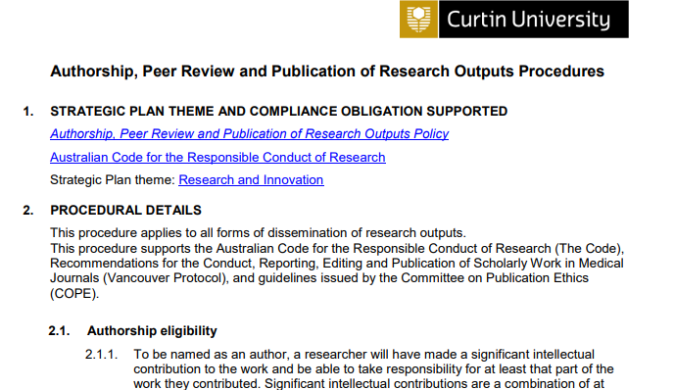
Authorship, Peer Review and Publication of Research Outputs

Slide 13
Authorship Agreements
Put an agreement in place before the commencement of writing a research project - no need for a formal legal document, eg can be emails or a signed form/letter
Authorship on great papers is the equivalent to gold.
  Authorship is a commodity and has value.
There are standard systems to award authorship.
  automatically give Authorship to the person who owns
  the instrument or is Head of Department?
  automatically give Authorship to the supervisor?
  Is that OK?
  The world has changed ….it is NOT appropriate to do this
  (See S2.1.3 of Procedures)
If an academic fulfils the role of an advisor and collaborator in the development and guidance of the research paper then it would seem obvious that they should be/ would be an author.

Slide 14
Attribution
4.1 The acknowledgment of the contributions of various people who made the HDR completion possible is important to include at the beginning of a thesis or exegesis. In addition, it is important to attribute appropriate any contributions to the genesis, thematic development and synthesis of data or concepts that advanced the development of a research output.
4.2 During the writing of a HDR thesis, students are encouraged to publish their work during their enrolment. The publications are often with multiple authors. If the work is co-authored, and is included as part of the thesis, either as a publication or it is used to form, or inform, one or more parts of the thesis text, it is essential for the student to declare that the work was co-authored. Within the thesis this is called attribution.
4.3 If a co-authored paper, or material or original concepts from that co-authored work are used in the thesis, it is essential that an attribution statement is included in the thesis.

Slide 15
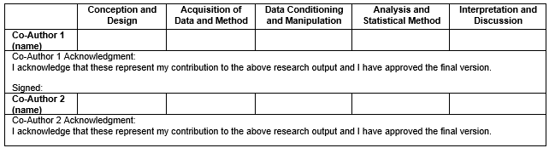
Attribution Statement
Percentage contribution by field of activity: Indicate the percentage time for each co-author.

Slide 16
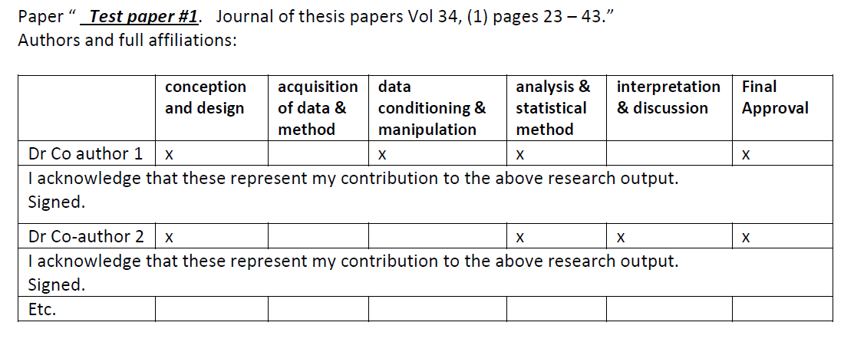
Authorship – Roles vs % allocation
Examples…

Slide 17
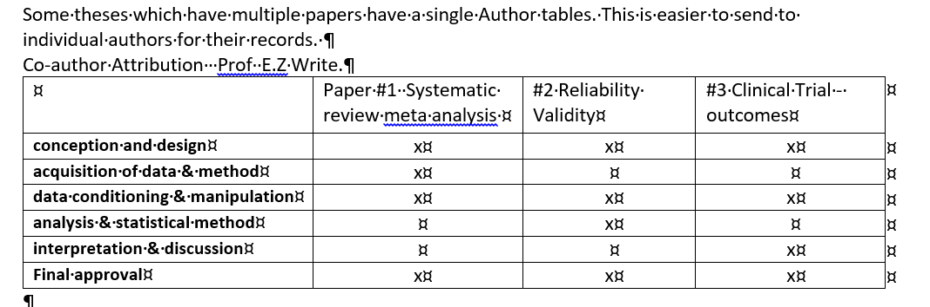
Go to the website and find the attribution statement

Slide 18
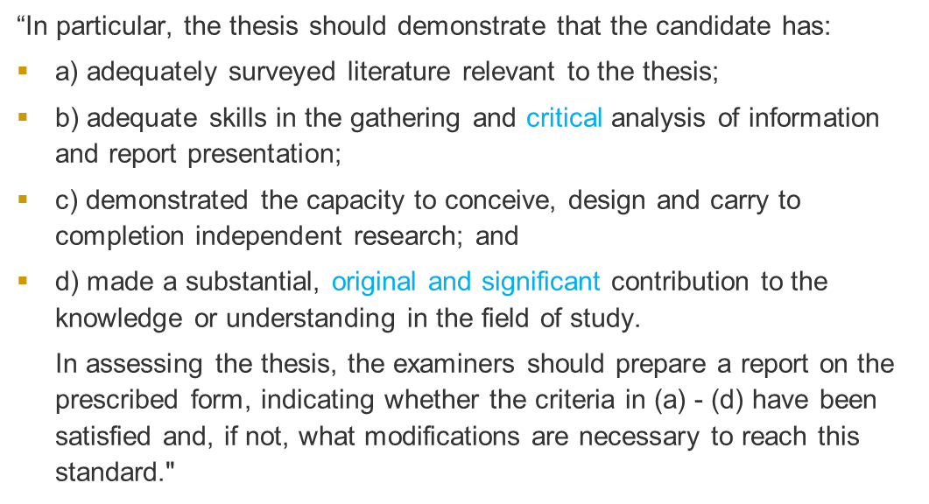
Criteria to Examine a Doctoral thesis

Slide 19
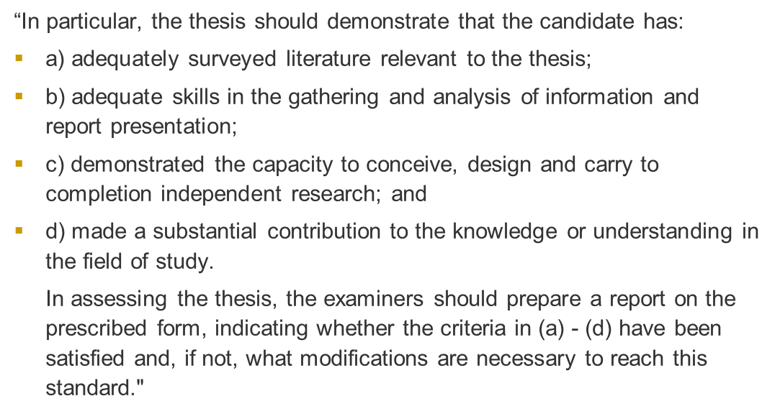
Criteria to Examine a Master’s thesis

Slide 20

Lastly - understand Academic Integrity
Universities Australia (2017) definition: ‘Academic integrity means acting with the values of honesty, trust, fairness, respect, and responsibility in learning, teaching and research’.
Principles of academic integrity align with Curtin’s core values (integrity, respect, courage, excellence and impact).
“Plagiarism is presenting the work or property of another person as your own without appropriate acknowledgement or referencing…”
See Academic Integrity Governance; Academic Integrity student essentials
Management of Academic Integrity Warnings for New to Curtin Students Procedure
And submit your work to Turnitin using links in the Research Integrity training on Blackboard!

Slide 21
Publishing Power Hours 2021
1 - Publishing in quality journals, Tuesday September 7, 12:00pm – 1:00pm
2 - Predatory journals, Thursday September 16, 12:00pm – 1:00pm
3 - Open access publishing, Thursday September 23, 12:00pm – 1:00pm
4 - Publishing your research data, Wednesday September 29, 12:00pm – 1:00pm
5 - Publishing your software code, Thursday September 30, 12:00 – 1:00pm
6 - Publishing copyright essentials, Thursday October 7, 12:00pm – 12:30pm
7 - Getting your article published, Wednesday October 13, 12:00pm – 1:00pm
8 - Making EndNote work for you and your publications, Thursday October 21, 12:00pm – 1:00pm
9 - Measuring the impact of your research publications, Thursday October 28, 12:00pm – 1:00pm
https://bookings.library.curtin.edu.au/calendar/workshops

Slide 22
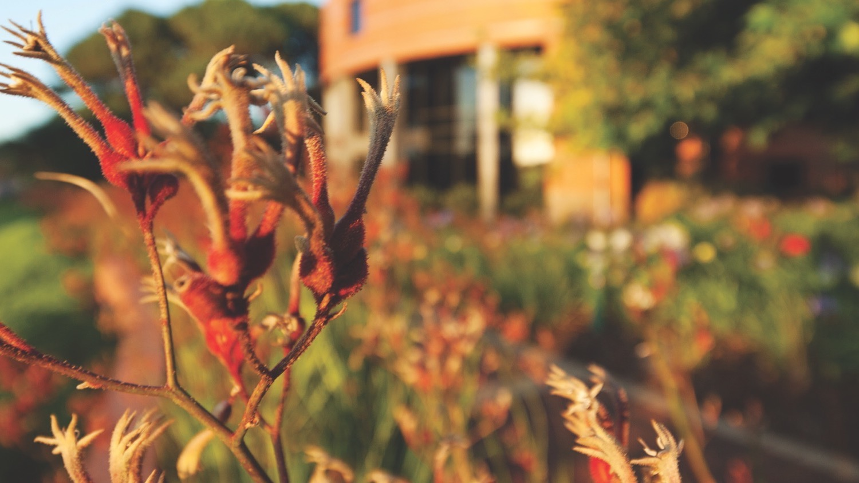
Thank you
Make tomorrow better.

