Slide 1
Thesis by Compilation A Student Perspective René Kathleen Forsyth PhD Candidate August 2021

Slide 2
Writing Papers for Publication
You will already have your hypothesis and an understanding of your data and the direction you want the paper to take
Before you dive too deep, think about which Journal you intend to submit
Types of papers accepted
Word counts
How many Tables and Figures you may have
Subheadings

Slide 3
After you submit to a Journal…
Be prepared…
To wait
To feel rejection
To feel frustration
To feel elation
To ugly cry on the floor…

Slide 4
After you submit to a Journal…
Be prepared…
To wait
To feel rejection
To feel frustration
To feel elation
To ugly cry on the floor…
This is not a drill!

Slide 5
After you submit to a Journal…
Be prepared…
To wait
To feel rejection
To feel frustration
To feel elation
To ugly cry on the floor…
Have a plan in mind for the next step
It is no good waiting for this paper to come back
It can take weeks… months

Slide 6
Every Rejection is an Opportunity
While rejection (sometimes over and over again) is frustrating….
It helps you grow!
It challenges the way you think and may reveal things you hadn’t previously thought of
Every bit of feedback will shape the next step
The reviewer may have a unique experience or take that you and your supervisors may not have considered

Slide 7
It can be hard to not take rejections personally… but the examiners don’t know who you are, it’s not personal for them, it’s science!

Slide 8
Thesis Template
Start to think about your Thesis Template early
How will each of your papers flow from one to the next?
What is the story you’re trying to tell?
How many papers will you need to complete the story?
Is a systematic literature review required?
Don’t forget you can publish systematic reviews too!

Slide 9
Hot Tips
Citation Manager (Endnote)
Makes referencing in Word a dream
Can also make notes within the data base
Can attached the PODF inside EndNote to find it easily later

Slide 10
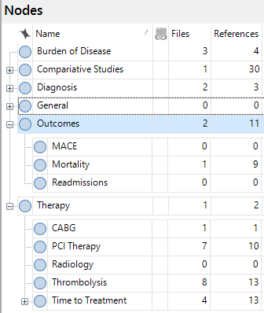
Hot Tips
nVIVO
Take the course, start using it early, use it well!
Text searches – will search inside PDFs!
Can code documents as you review them (nodes)

Slide 11
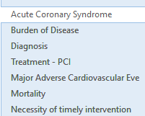
Hot Tips
Good old fashioned notebook…. or OneNote
I used OneNote for my literature Review
OneNote has a Search function
Links with iPad for notes on the go

Slide 12
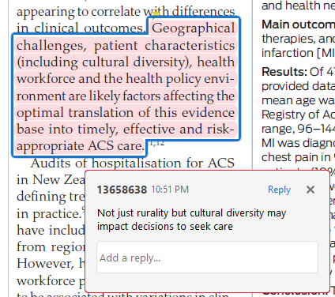
Hot Tips
How will you review your literature and keep on top of it?
One paper per night?
Highlight on iPad or PC?
Make Notes
How will you store your paraphrasing?

Slide 13
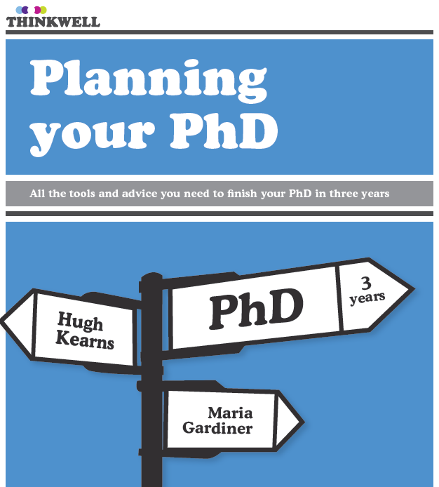
Resources

Slide 14
Questions?

