Slide 1
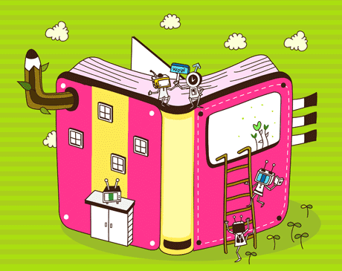
Writing Papers Hybrid Thesis (in prep, submitted, published & in press papers) Kliti’s Experience & Tips 30th August 2021

Slide 2
General-1
Two kinds of papers- Creative/ Analytical.
Writing a paper can be a primary mechanism for setting out research (review paper) -- not just a mechanism for reporting it!
Reporting research--- A question (problem), literature review, analysis, methodology for original research, results, conclusion, & references (up to date & primary reference material).
Have a solid compelling piece of research.
Decide on authorship early– discuss with supervisors & co-authors.
Target journal- know your audience & journal format.

Slide 3
Scaffolding Tips
Template or outline of paper format. E.g. previous student’s paper as template. On-line template.
An outline - a mindmap (foundation), a list of points to cover, a statement of purpose, a mental image of your finished paper. You need foundations & scaffolding to build a paper.
Start with figures with data that tell the story. High quality figures. Multiple versions might be needed. These are also discussion points- supervisors & students.
Start broad, then dive into the specifics.

Slide 4
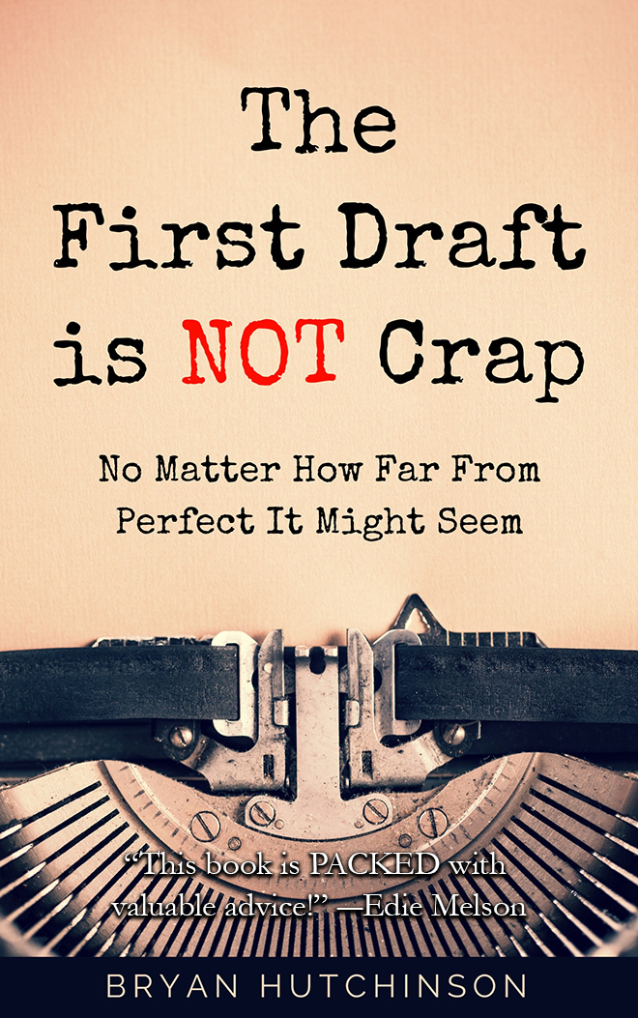
First Tips
First draft won’t be perfect — you can polish later on.
Attention to clear organization & logical ordering of paragraphs & sentences.
Express ideas as clearly as possible.
Do not need to start by writing the introduction. Begin where it feels most natural for you — you might prefer to finish the most difficult sections first, or you might choose to start with the easiest part. Use your mindmap.
Never delete large sections of text- place it in a different document, but don’t delete it —might be useful later.
Expect multiple drafts. Feedback is critical on drafts.
Constantly do a spell check at the end of each writing session. Backup.
Email a copy to yourself.

Slide 5
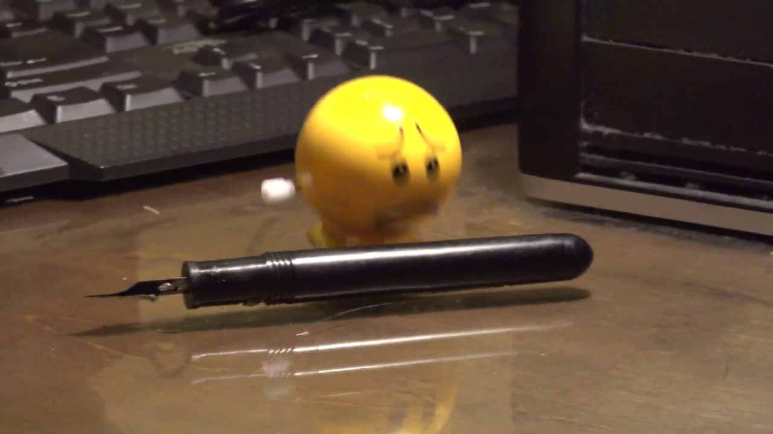
Writer’s Block
Discipline yourself.
Set aside time to write a little bit each day (500 words, 1 paragraph) & end your writing session at a place where you’ll be able to easily pick up the thread the following day.
Work on sections that you find easiest- e.g. materials & methods.
Feedback from supervisors – co-authors- early on- work in progress.

Slide 6
Writer’s Block
Use "imperfect" words
Don’t spend hours looking for a perfect word ….simply write what you’re thinking, whether it’s eloquent or not. Come back & refine it later.
Change your environment.
Change to pen & paper.
Never write a paper from start to finish with no discussions.

Slide 7
Hybrid Thesis – WA-OIGC
Minimum – three chapters peer-reviewed international papers (submitted, in press, in prep) in Hybrid Thesis
Writing weeks- set aside- mentor, supervisor
Always Celebrate Writing Achievements

